Slide 1
Topic07.Exploring/managing data!
資料科學 Data Science
張家銘 Jia-Ming Chang
政治大學資訊科學系
The slide isonly for educational purposes. If any infringement, please contact me, we will correct immediately.

Slide 2
Copyright declaration 版權說明
Some of the figures in this presentation are taken from "An Introduction to Statistical Learning, with applications in R" (Springer, 2013) with permission from the authors: G. James, D. Witten, T. Hastie and R. Tibshirani.
The web site of the book
The credit of individual is indicated in the bottom part of the slide.
ie.,

Slide 3
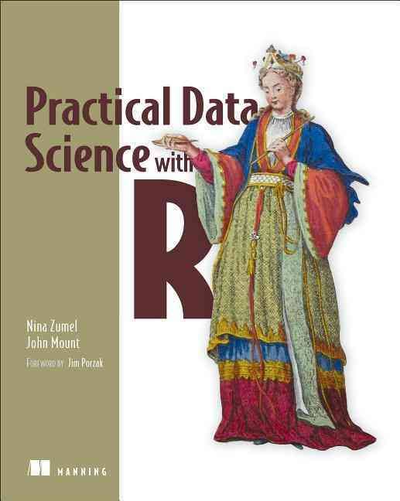
Copyright declaration 版權說明
Some of the figures in this presentation are taken from "Practical Data Science with R" (Manning, 2019)
The web site of the book
The credit of individual is indicated in the bottom part of the slide.
ie.,

Slide 4
Copyright declaration 版權說明
Some of the figures in this presentation are taken from "R for Data Science” under the Creative Commons Attribution-NonCommercial-NoDerivs 3.0 License.
The web site of the book
The credit of individual is indicated in the bottom part.
ie.,

Slide 5
Data Science this week
In-depth introduction to machine learning in 15 hours of expert videos
https://www.r-bloggers.com/in-depth-introduction-to-machine-learning-in-15-hours-of-expert-videos/

Slide 6
Recap for the last week

Slide 7
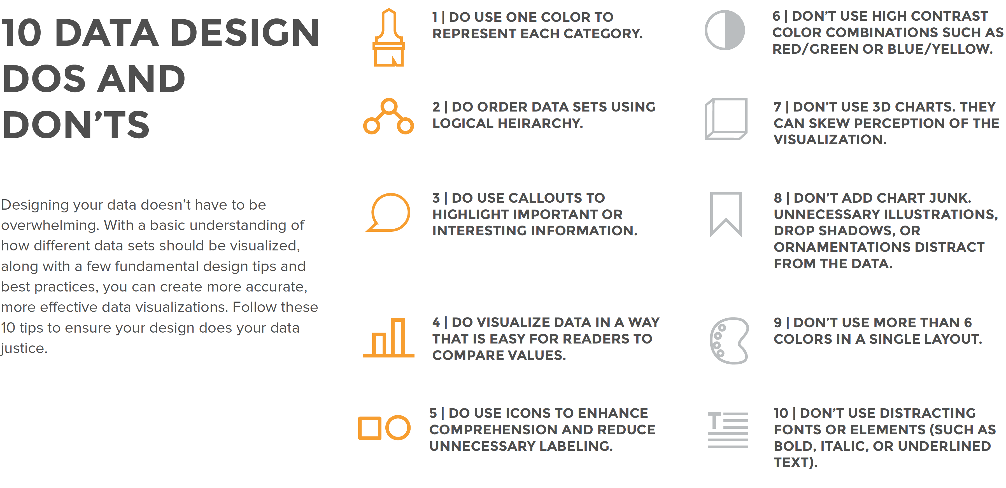
Credit by Data Visualization 101: How To Design Charts and Graphs, by HubSpot and Visage

Slide 8
Interaction
mtcars %>% ggvis(~mpg, ~disp, size = ~vs) %>% layer_points()
mtcars %>% ggvis(~wt, ~mpg, size := 300, opacity := 0.4) %>% layer_points()
=>
mtcars %>% ggvis(~wt, ~mpg, size := input_slider(10, 100), opacity := input_slider(0, 1) ) %>% layer_points()
=>
slider <- input_slider(10, 1000)
mtcars %>% ggvis(~wt, ~mpg) %>% layer_points(fill := "red", opacity := 0.5, size := slider)
Credit by http://ggvis.rstudio.com/ggvis-basics.html

Slide 9
Interaction, input_*
input_checkbox(): a check-box
input_checkboxgroup(): a group of check boxes
input_numeric(): a spin box
input_radiobuttons(): pick one from a set options
input_select(): create a drop-down text box
input_text(): arbitrary text input
Credit by hhttp://ggvis.rstudio.com/interactivity.html

Slide 10

Shiny
an R package that makes it easy to build interactive web applications (apps) straight from R.
http://shiny.rstudio.com/
Credit by http://shiny.rstudio.com/tutorial/lesson1/

Slide 11
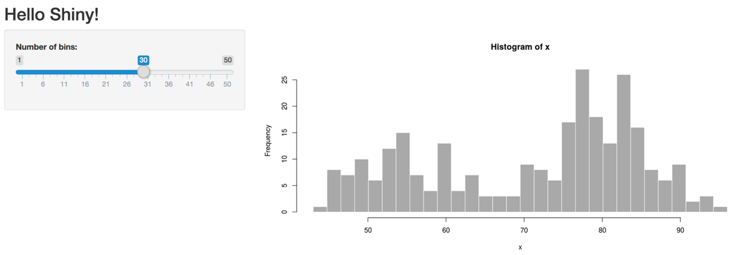
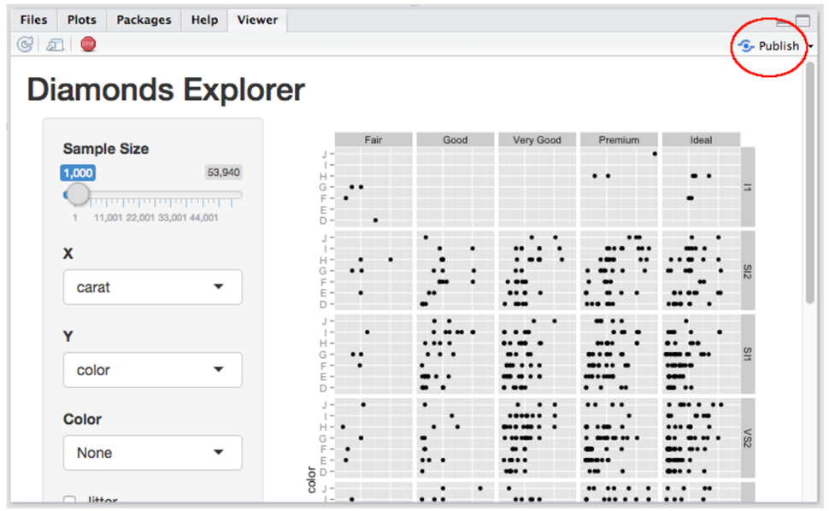
Share by Shinyapps.io
https://changlab.shinyapps.io/app1/

Slide 12
Today
Chp. 3: Exploring data
Chp. 4: Managing data

Slide 13
Today
Cha 7. Exploratory Data Analysis
Cha 11. Data import

Slide 14
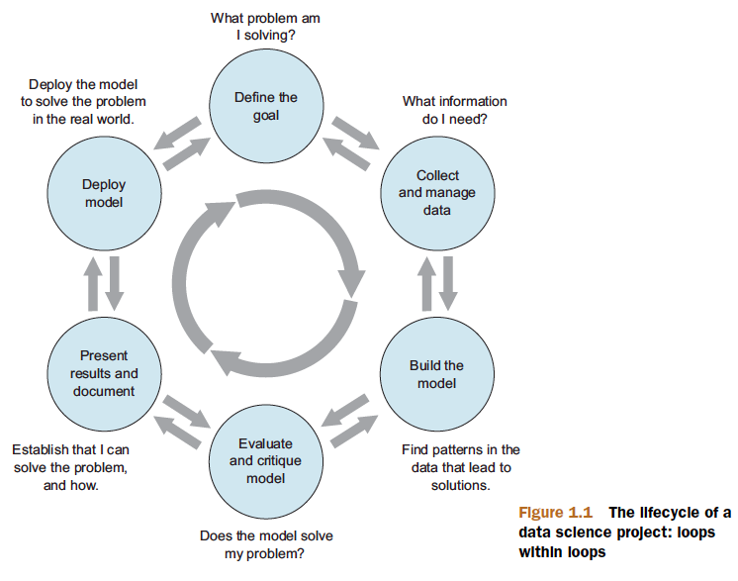
Data Science project
Figure1.1, Practical Data Science with R by Nina Zumel, John Mount

Slide 15
Explore & Manage data
The data exploration and data cleaning stages are two of the more time-consuming—and also the most important—stages of the process.
Without good data, you can’t build good models.
Time you spend here is time you don’t waste elsewhere.

Slide 16
Data Import by tidyverse package

Slide 17
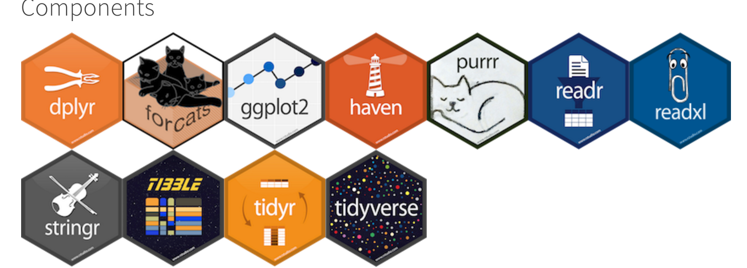
http://tidyverse.org/
a collection of R packages that share common philosophies and are designed to work together.
This site is a work-in-progress guide to the tidyverse and its packages.
install.packages("tidyverse")

Slide 18
Import functions
library(tidyverse)
read_csv() reads comma delimited files
ead_csv2() reads semicolon separated files
read_tsv() reads tab delimited files
read_delim() reads in files with any delimiter.
read_fwf() reads fixed width files
read_log() reads Apache style log files.
R for Data Science by Garrett Grolemund, Hadley Wickham

Slide 19
read_csv
heights <- read_csv("heights.csv")
What is different with read.csv()?
R for Data Science by Garrett Grolemund, Hadley Wickham

Slide 20
read_csv vs. read.csv
They are typically much faster (~10x) than their base equivalents. Long running jobs have a progress bar, so you can see what’s happening.
If you’re looking for raw speed, try data.table::fread(). It doesn’t fit quite so well into the tidyverse, but it can be quite a bit faster.
R for Data Science by Garrett Grolemund, Hadley Wickham

Slide 21
read_csv vs. read.csv
They produce tibbles, they don’t convert character vectors to factors, use row names, or munge the column names.
These are common sources of frustration with the base R functions.
R for Data Science by Garrett Grolemund, Hadley Wickham

Slide 22
read_csv vs. read.csv
They are more reproducible. Base R functions inherit some behavior from your operating system and environment variables, so import code that works on your computer might not work on someone else’s.
R for Data Science by Garrett Grolemund, Hadley Wickham

Slide 23
Writing to a file
writeData.R
library(tidyverse)
challenge <- read_csv(readr_example("challenge.csv"))
write_csv(challenge, "challenge.csv")
R for Data Science by Garrett Grolemund, Hadley Wickham

Slide 24
write_rds & read_rds
# store data in R’s custom binary format called RDS
write_rds(challenge, "challenge.rds")
read_rds("challenge.rds")
R for Data Science by Garrett Grolemund, Hadley Wickham

Slide 25
save() vs. saveRDS()
mod <- lm(mpg ~ wt, data = mtcars)
mod
save(mod, file = "mymodel.rda")
ls()
load(file = "mymodel.rda")
ls()
saveRDS(mod, "mymodel.rds")
mod2 <- readRDS("mymodel.rds")
ls()
identical(mod, mod2, ignore.environment = TRUE)
R for Data Science by Garrett Grolemund, Hadley Wickham

Slide 26
save() vs. saveRDS()
save()
save many objects to a file in a single call
maintaining the original name
saveRDS()
being a lower-level function, works with a single object at a time
forgets the original name of the object
R for Data Science by Garrett Grolemund, Hadley Wickham

Slide 27
Exploring data

Slide 28
Exploring data
Using summary statistics to explore data
Exploring data using visualization
Finding problems and issues during data exploration
Practical Data Science with R by Nina Zumel, John Mount​

Slide 29
Data exploration
summary statistics: means and medians, variances, and counts
Visualization: graphs of the data

Slide 30
Custdata
expData.R
custdata.tsv
Click “raw” to download it
Load data
custdata <- read.table('custdata.tsv',header=TRUE,sep='\t')
Practical Data Science with R by Nina Zumel, John Mount

Slide 31
Data
exampleData.rData
Load data
load("exampleData.rData")
Practical Data Science with R by Nina Zumel, John Mount

Slide 32
Setting expectations
Is data you have available is good enough?
Very important in data science!!!

Slide 33
Using summary statistics to spot problems
Which gender has higher employed rate?
Any problem?
summary(custdata)
Practical Data Science with R by Nina Zumel, John Mount

Slide 34
Spotting problems using graphics and visualization
A graphic should display as much information as it can, with the lowest possible cognitive strain to the viewer.
Visualization is an iterative process. Its purpose is to answer questions about the data.
Practical Data Science with R by Nina Zumel, John Mount

Slide 35
Spotting problems using graphics and visualization
Make the data stand out. Specific tips for increasing clarity include
Avoid too many superimposed elements, such as too many curves in the same graphing space.
Find the right aspect ratio and scaling to properly bring out the details of the data.
Avoid having the data all skewed to one side or the other of your graph.
Practical Data Science with R by Nina Zumel, John Mount

Slide 36
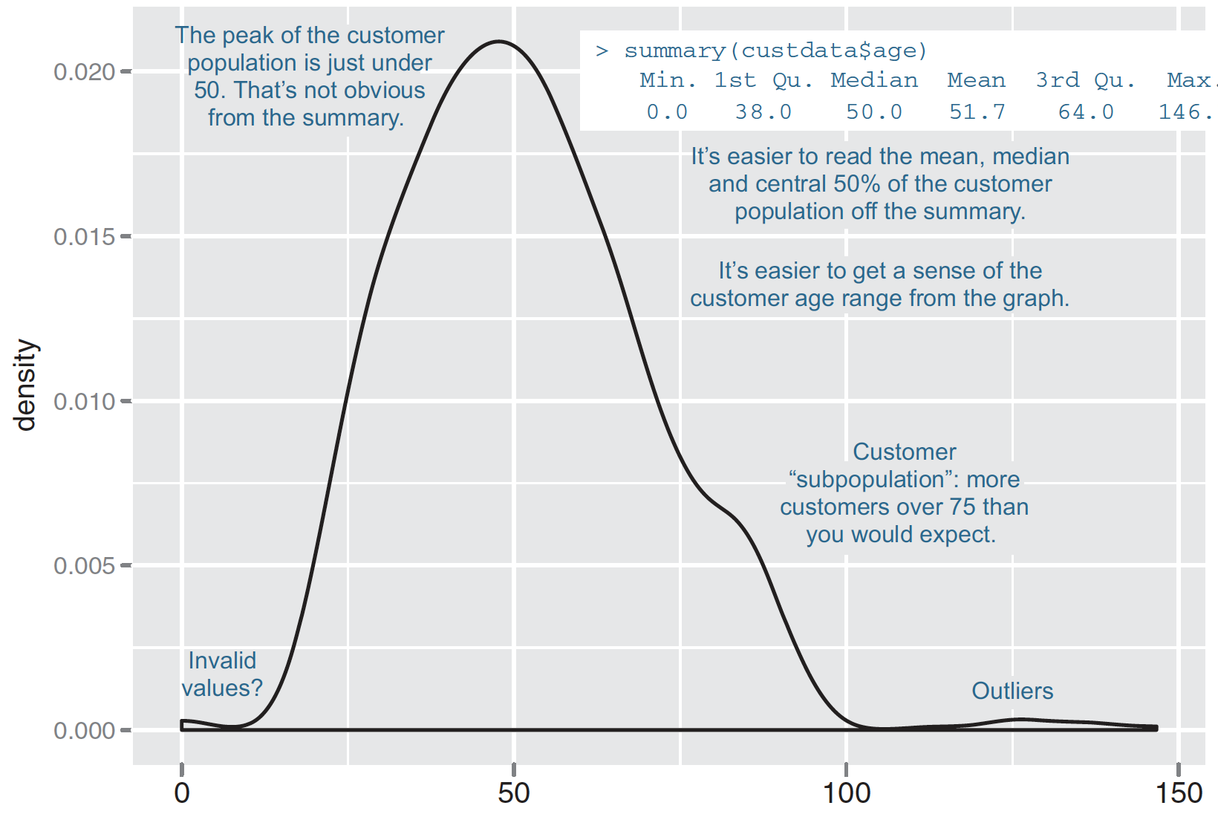
Some information is easier to read from a graph, and some from a summary
Figure 3.1, Practical Data Science with R by Nina Zumel, John Mount

Slide 37
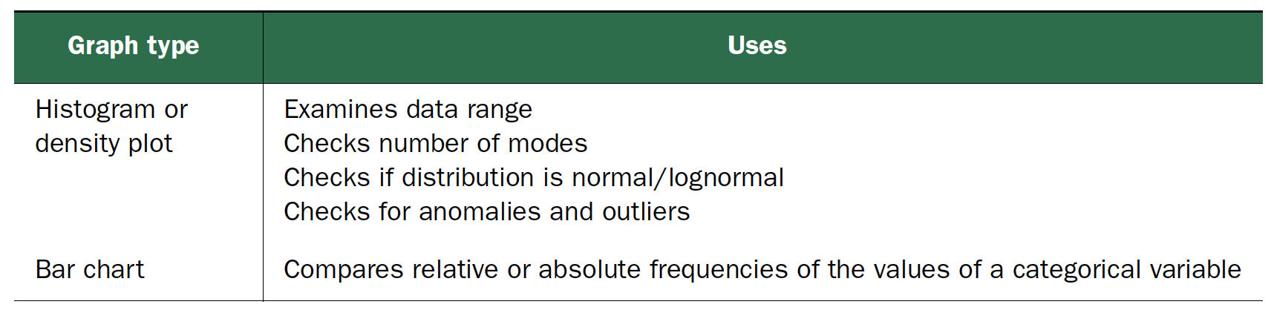
Visualizations for one variable
Practical Data Science with R by Nina Zumel, John Mount

Slide 38
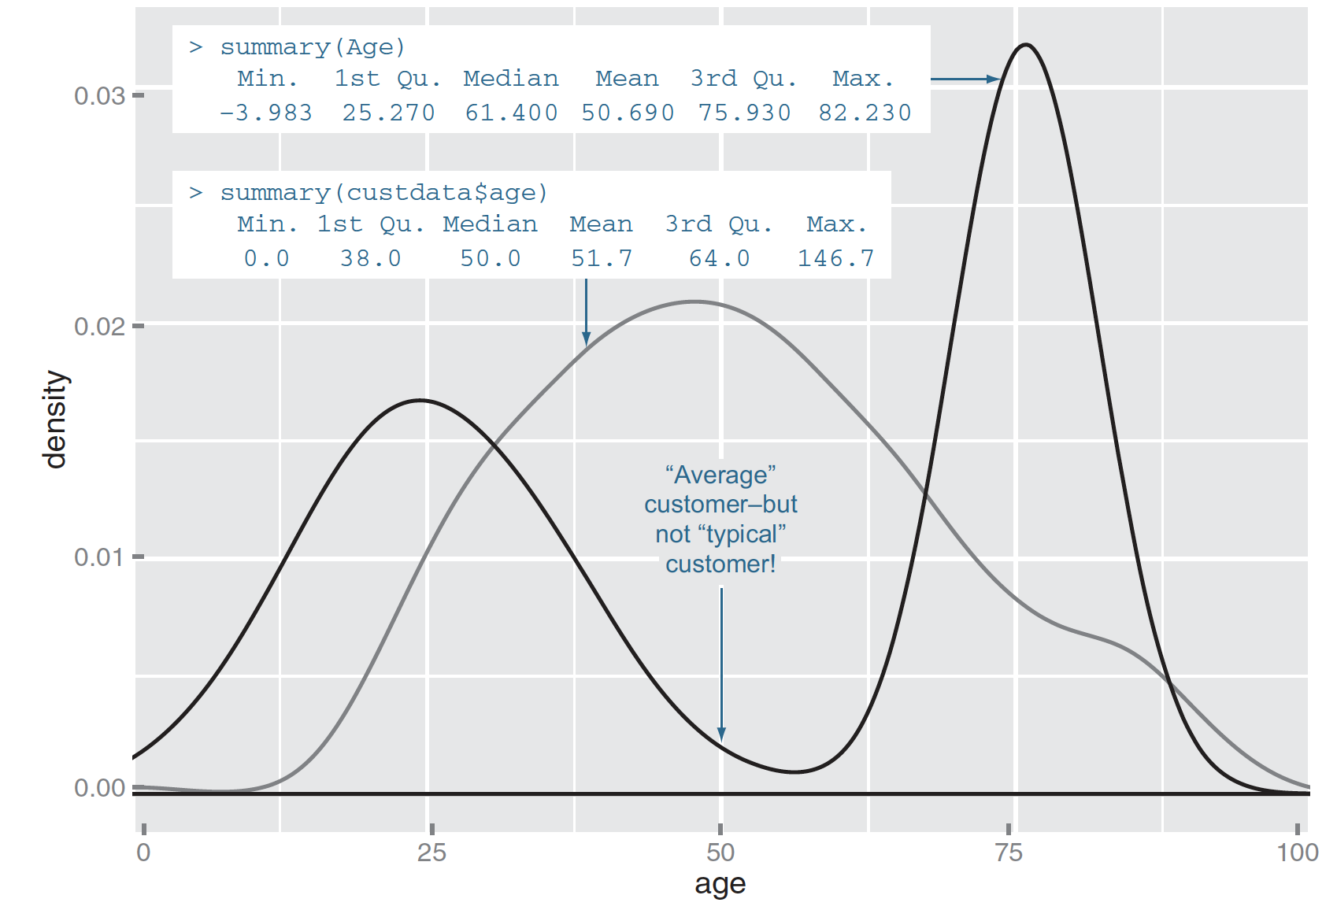
Visually checking distributions for a single variable
What is the peak value of the distribution?
How many peaks are there in the distribution (unimodality vs bimodality)?
How normal (or lognormal) is the data?
How much does the data vary? Is it concentrated in a certain interval or in a certain category?
Figure3.2, Practical Data Science with R by Nina Zumel, John Mount

Slide 39
Visually checking distributions for a single variable
Unimodal, bimodal, multimodal
It wouldn’t be a bad idea to model the two populations separately - especially if you’re using linear or logistic regression
Figure3.2, Practical Data Science with R by Nina Zumel, John Mount

Slide 40
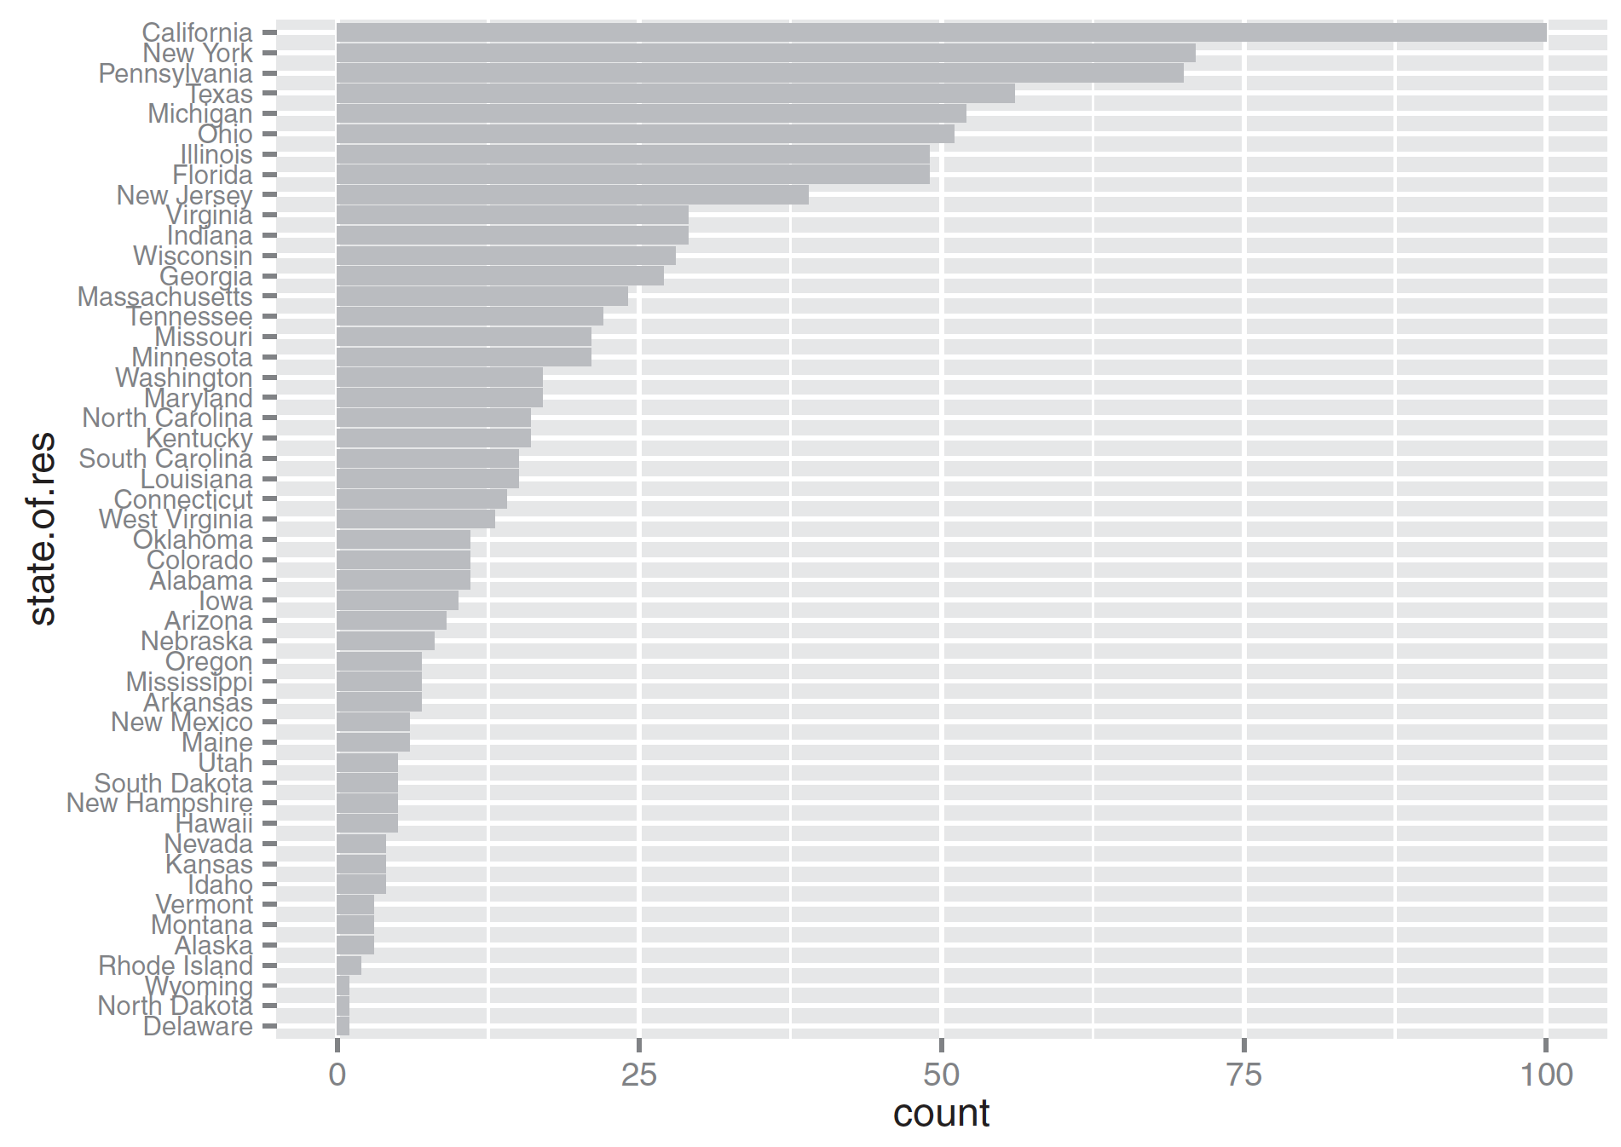
Bar Charts
statesums <- table(custdata$state.of.res)
statef <- as.data.frame(statesums)
colnames(statef)<-c("state.of.res", "count")
statef <- transform(statef, state.of.res=reorder(state.of.res, count))
ggplot(statef)+ geom_bar(aes(x=state.of.res,y=count),
stat="identity", fill="gray") + coord_flip() + theme(axis.text.y=element_text(size=rel(0.8)))
Figure3.8, Practical Data Science with R by Nina Zumel, John Mount

Slide 41
Typical problems revealed by data summaries
Missing Values
Invalid Values and Outliers
Units
Data Range => Managing data
Practical Data Science with R by Nina Zumel, John Mount

Slide 42
1.Missing value

Slide 43
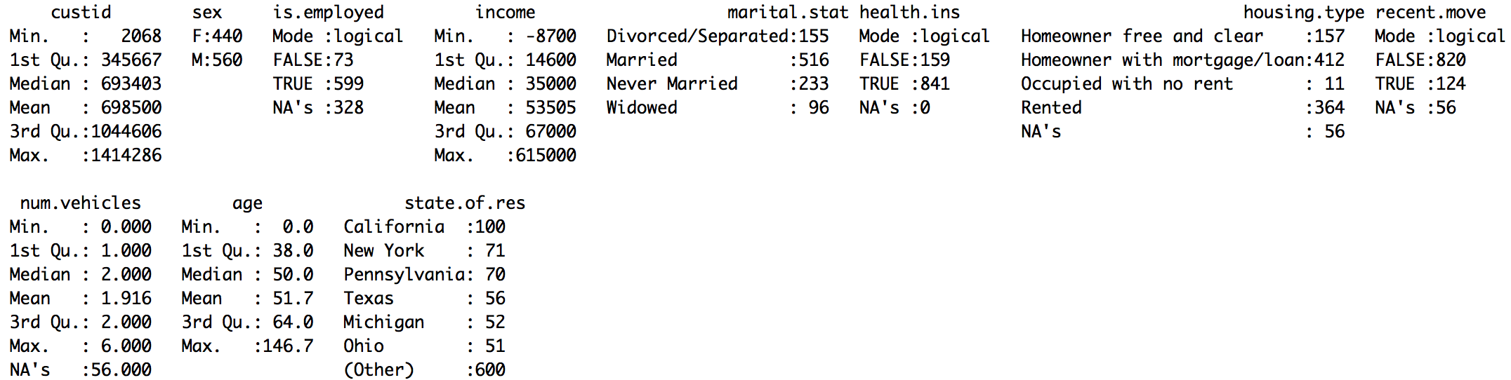
Missing Values
Sometimes the fact that a value is missing is informative in and of itself
Is employment status unknown?
Did the company start collecting employment data only recently?
Does NA mean “not in the active workforce”
Practical Data Science with R by Nina Zumel, John Mount

Slide 44
Missing Values
Do you include a variable with missing values in your model, or not?
Proportion matter
Practical Data Science with R by Nina Zumel, John Mount

Slide 45
How to treat missing data?
Drop all the rows where this field is missing
Convert the missing values to o or to an additional category
Practical Data Science with R by Nina Zumel, John Mount

Slide 46
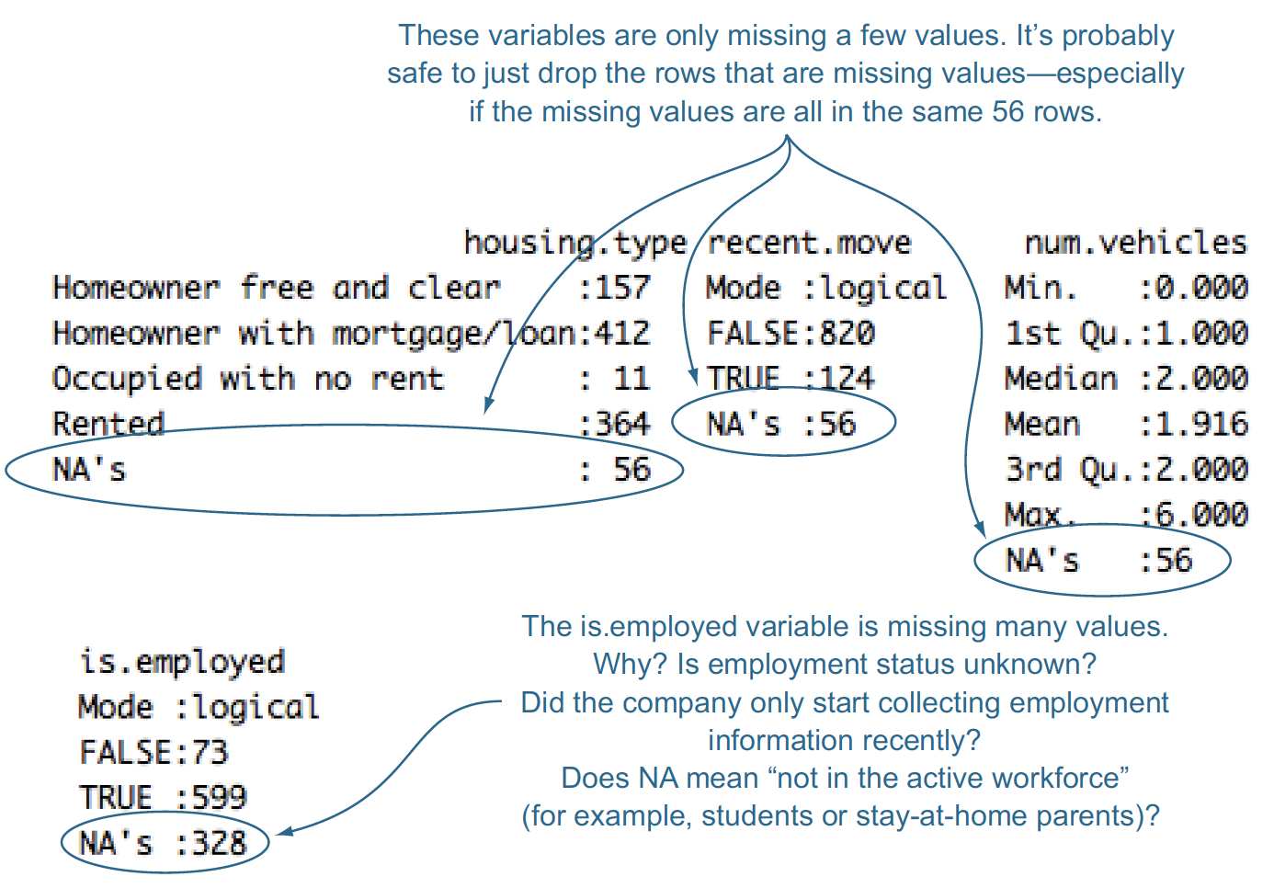
Treating missing values (NAs)
To Drop Or Not To Drop?
summary(custdata[is.na(custdata$housing.type), c("recent.move","num.vehicles")])
Figure 4.1, Practical Data Science with R by Nina Zumel, John Mount

Slide 47
Missing Data In Categorical Variables
custdata$is.employed.fix <- ifelse(is.na(custdata$is.employed),
"missing",
ifelse(custdata$is.employed==T,
"employed",
"not employed"))
summary(as.factor(custdata$is.employed.fix))
custdata$is.employed.fix <- ifelse(is.na(custdata$is.employed),
"not in active workforce",
ifelse(custdata$is.employed==T,
"employed",
"not employed"))
Practical Data Science with R by Nina Zumel, John Mount

Slide 48
Missing Data In Categorical Variables
NA =>“missing” : prevent that most analysis functions in R will, by default, drop rows with missing data.
Why a new variable?
a new variable called is.employed.fix, rather than simply replacing is.employed.
have the original variable on hand, in case we second-guess our data cleaning and want to redo it.
Practical Data Science with R by Nina Zumel, John Mount

Slide 49
Missing values in numeric data
summary(custdata$Income)
Two types
When values are missing randomly
When values are missing systematically
Practical Data Science with R by Nina Zumel, John Mount

Slide 50
When values are missing randomly
meanIncome <- mean(custdata$Income, na.rm=T)
Income.fix <- ifelse(is.na(custdata$Income),
meanIncome,
custdata$Income)
summary(Income.fix)
summary(custdata$Income)
Practical Data Science with R by Nina Zumel, John Mount

Slide 51
When values are missing systematically
One thing you can do is to convert the numeric data into categorical data
breaks <-c(0, 10000, 50000, 100000, 250000, 1000000) Income.groups <- cut(custdata$income, breaks=breaks, include.lowest=T)
summary(Income.groups)
Income.groups <- as.character(Income.groups) Income.groups <- ifelse(is.na(Income.groups), "no income", Income.groups)
summary(as.factor(Income.groups))
Practical Data Science with R by Nina Zumel, John Mount

Slide 52
Tracking original NAs with an extra categorical variable
missingIncome <- is.na(custdata$Income)
Income.fix <- ifelse(is.na(custdata$Income), 0, custdata$Income)
Practical Data Science with R by Nina Zumel, John Mount

Slide 53
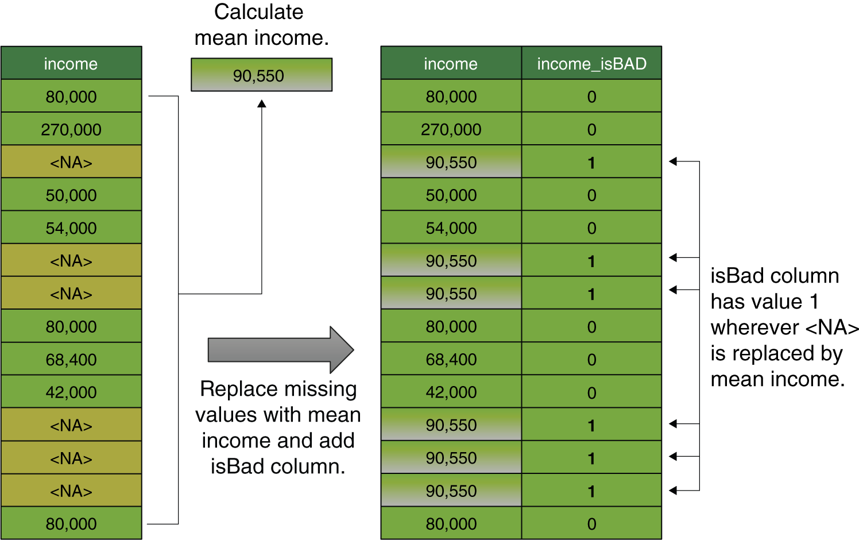
Replacing missing values with the mean and adding an indicator column to track the altered values
Credit by Figure 4.6 Practical Data Science with R by Nina Zumel, John Mount

Slide 54
2.Invalid Values and Outliers

Slide 55
Examples of invalid values and outliers
Negative values for income
Outliers: customers of
age zero
an age greater than about 110
Practical Data Science with R by Nina Zumel, John Mount

Slide 56
Variation
Visualising distributions
visVariation.R
ggplot(data = diamonds) + geom_bar(mapping = aes(x = cut))
What is the largest category?
library(tidyverse)
diamonds %>% count(cut)
R for Data Science by Garrett Grolemund, Hadley Wickham

Slide 57
Continuous variable
ggplot(data = diamonds) + geom_histogram(mapping = aes(x = carat), binwidth = 0.5)
diamonds %>% count(cut_width(carat, 0.5))
R for Data Science by Garrett Grolemund, Hadley Wickham
R for Data Science by Garrett Grolemund, Hadley Wickham

Slide 58
Overlay multiple histograms in the same plot
smaller <- diamonds %>% filter(carat < 3)
ggplot(data = smaller, mapping = aes(x = carat, colour = cut)) + geom_freqpoly(binwidth = 0.1)
R for Data Science by Garrett Grolemund, Hadley Wickham

Slide 59
Unusual values
unusual.R
ggplot(diamonds) + geom_histogram(mapping = aes(x = y), binwidth = 0.5)
Any outlier?
R for Data Science by Garrett Grolemund, Hadley Wickham

Slide 60
Unusual values
unusual.R
ggplot(diamonds) + geom_histogram(mapping = aes(x = y), binwidth = 0.5) + coord_cartesian(ylim = c(0, 50))
unusual <- diamonds %>% filter(y < 3 | y > 20) %>% arrange(y)
unusual
R for Data Science by Garrett Grolemund, Hadley Wickham

Slide 61
Handle unusual values
drop them
diamonds2 <- diamonds %>% filter(between(y, 3, 20))
mutate, what is advantage?
diamonds2 <- diamonds %>% mutate(y = ifelse(y < 3 | y > 20, NA, y))
ggplot(data = diamonds2, mapping = aes(x = x, y = y)) + geom_point()
R for Data Science by Garrett Grolemund, Hadley Wickham

Slide 62
Covariation
covairation.R
How the price of a diamond varies with its quality?
Which one is better way to answer the above question?
ggplot(data = diamonds, mapping = aes(x = price)) + geom_freqpoly(mapping = aes(colour = cut), binwidth = 500)
ggplot(data = diamonds, mapping = aes(x = price, y = ..density..)) + geom_freqpoly(mapping = aes(colour = cut), binwidth = 500)
R for Data Science by Garrett Grolemund, Hadley Wickham

Slide 63
3.Units

Slide 64
Looking at the data range of a variable
Too narrow
wouldn’t be a very good predictor if not vary much at all => standard deviation / the mean
Unit also matter
Practical Data Science with R by Nina Zumel, John Mount

Slide 65
Checking units can prevent inaccurate results later
Income = custdata$income/1000
summary(Income)
Practical Data Science with R by Nina Zumel, John Mount

Slide 66
4.Data ranging => manage data

Slide 67
Managing data
Fixing data quality problems
Organizing your data for the modeling process
Practical Data Science with R by Nina Zumel, John Mount

Slide 68
Data transformations
make data easier to model—and easier to understand
converting continuous variables to discrete
normalizing variables
Log transformations
Practical Data Science with R by Nina Zumel, John Mount

Slide 69
Converting continuous variables to discrete
Their exact value matters less than whether they fall into a certain range
Discretizing continuous variables is useful when the relationship between input and output isn’t linear, but you’re using a modeling technique that assumes it is, like regression
Practical Data Science with R by Nina Zumel, John Mount

Slide 70
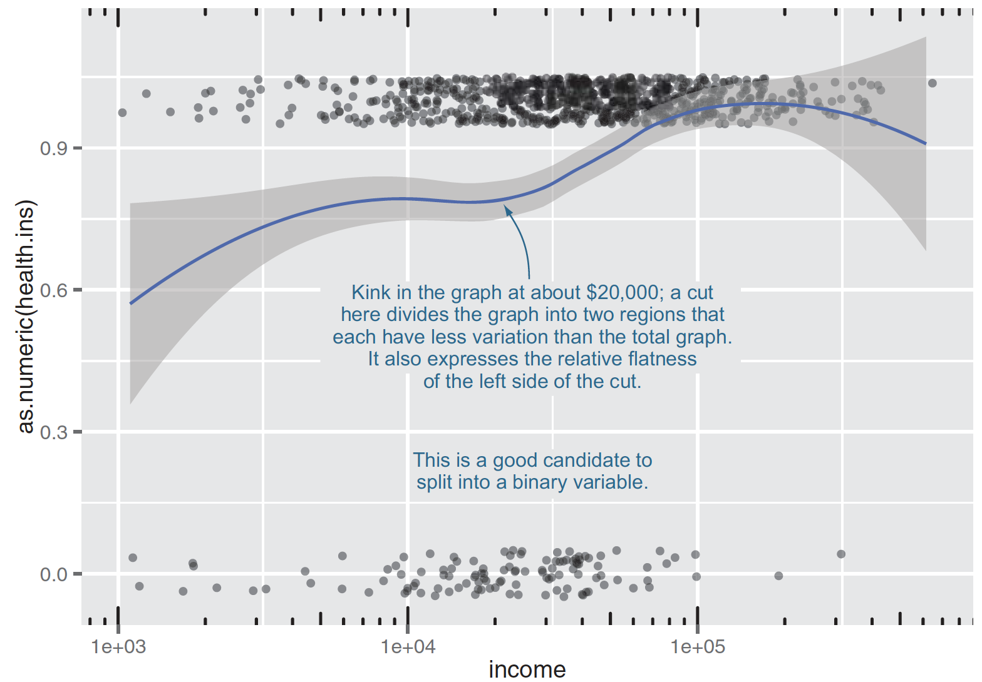
Converting continuous variables to discrete
manageData.R
custdata$income.lt.20K <- custdata$income < 20000
summary(custdata$income.lt.20K)
Figure 4.2, Practical Data Science with R by Nina Zumel, John Mount

Slide 71
Converting age into ranges
brks <- c(0, 25, 65, Inf)
custdata$age.range <- cut(custdata$age,
breaks=brks, include.lowest=T)
summary(custdata$age.range)
Practical Data Science with R by Nina Zumel, John Mount

Slide 72
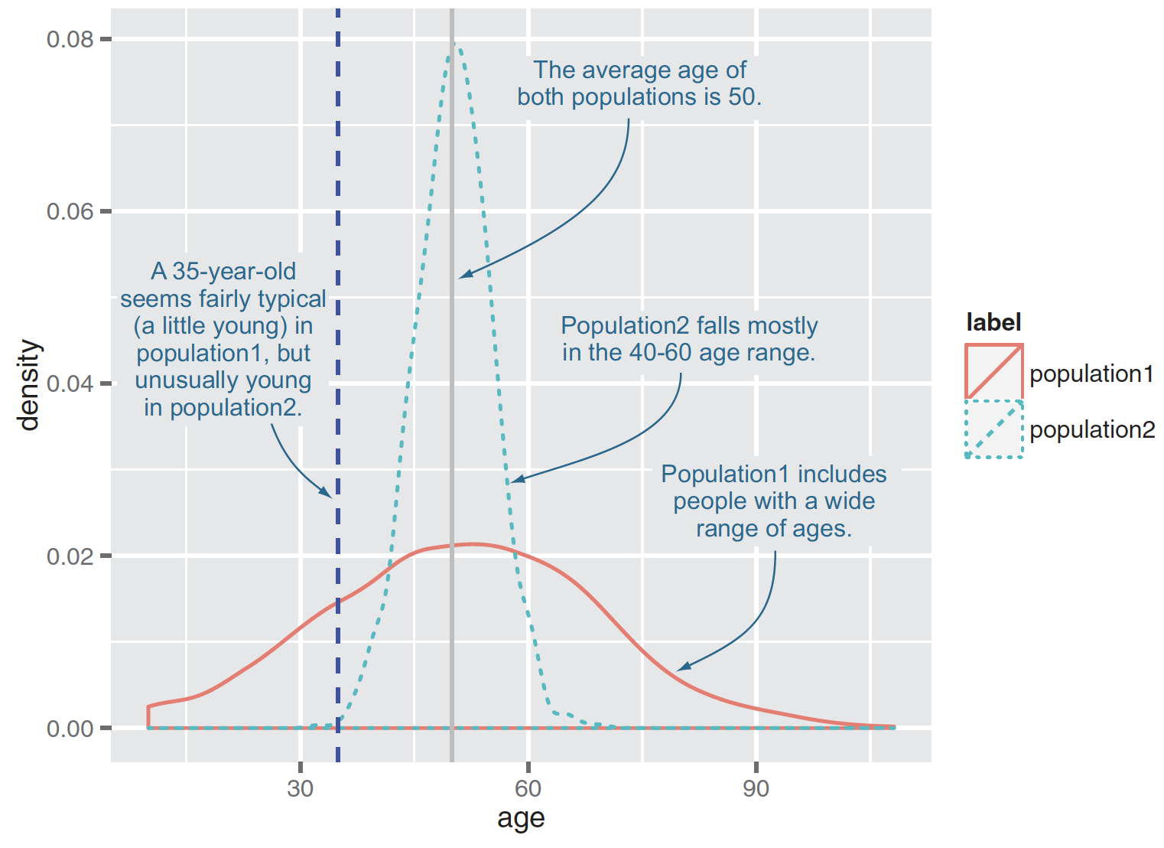
Normalization and rescaling
absolute quantities are less meaningful than relative ones
Code1
summary(custdata$age)
meanage <- mean(custdata$age)
custdata$age.normalized <- custdata$age/meanage
Figure4.3, Practical Data Science with R by Nina Zumel, John Mount

Slide 73
Normalization and rescaling
absolute quantities are less meaningful than relative ones
Code2
meanage <- mean(custdata$age)
stdage <- sd(custdata$age)
custdata$age.normalized <- (custdata$age-meanage)/stdage
SD is most meaningful as a unit of distance
the data is unimodal
roughly symmetric around the mean.
Figure4.3, Practical Data Science with R by Nina Zumel, John Mount

Slide 74
Looking at the data range of a variable
Too wide
Data that ranges over several orders of magnitude like this can be a problem for some modeling methods => might use logarithmic transformations
Practical Data Science with R by Nina Zumel, John Mount

Slide 75
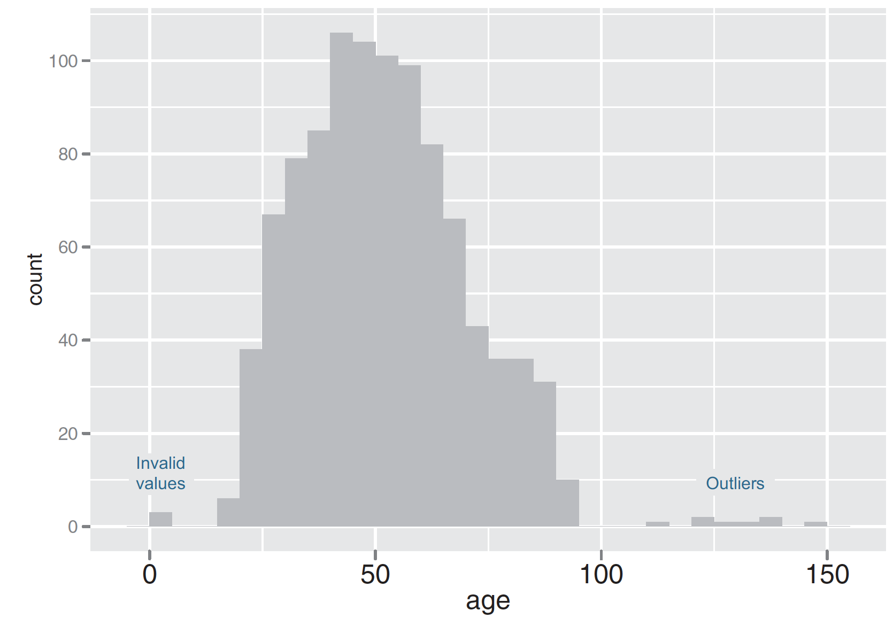
Plotting a histogram
ggplot(custdata) + geom_histogram(aes(x=age),
binwidth=5,fill="gray")
binwidth : geom_histogram make bins of five-year intervals
Default: datarange/30
fill : specifies the color of the histogram bars (default: black)
Figure3.3, Practical Data Science with R by Nina Zumel, John Mount

Slide 76
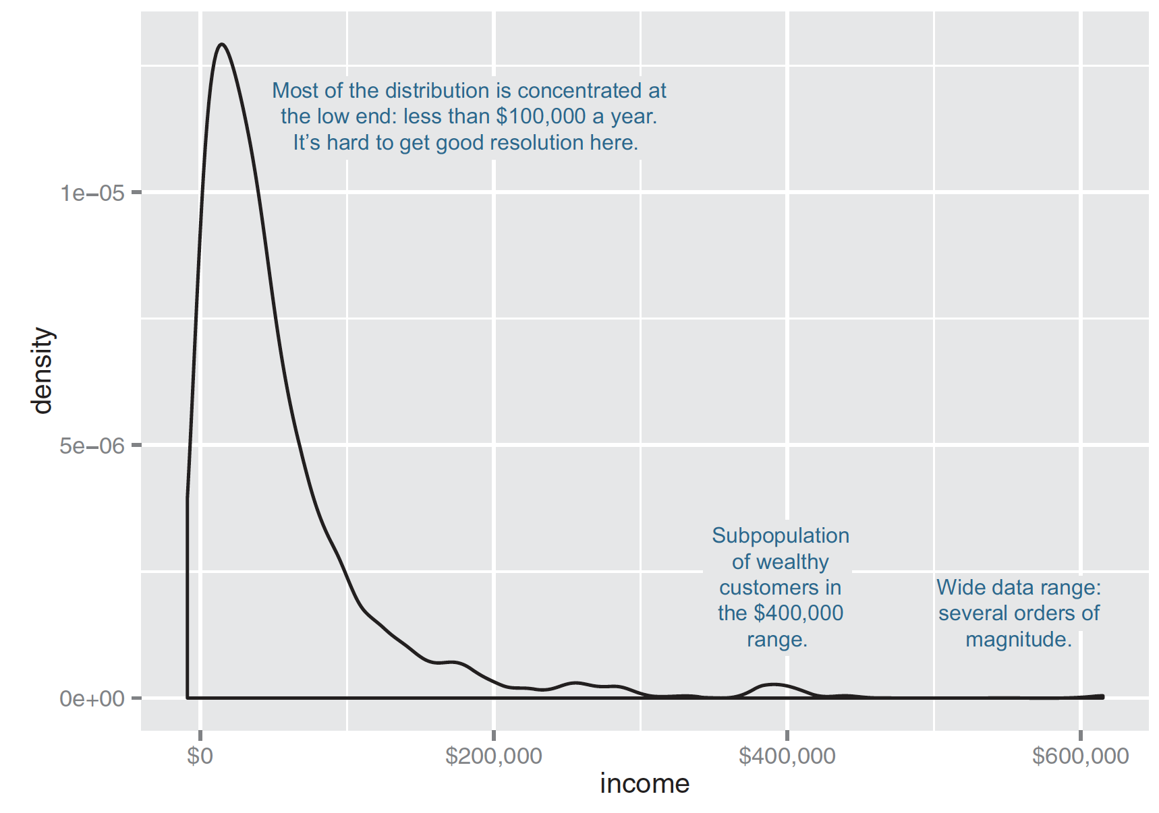
Density Plots
When the data range
very wide
the mass of the distribution is heavily concentrated to one side (difficult to see the details of its shape)
non-negative
library(scales)
ggplot(custdata) + geom_density(aes(x=income)) +
scale_x_continuous(labels=dollar)
Figure3.4,Practical Data Science with R by Nina Zumel, John Mount

Slide 77
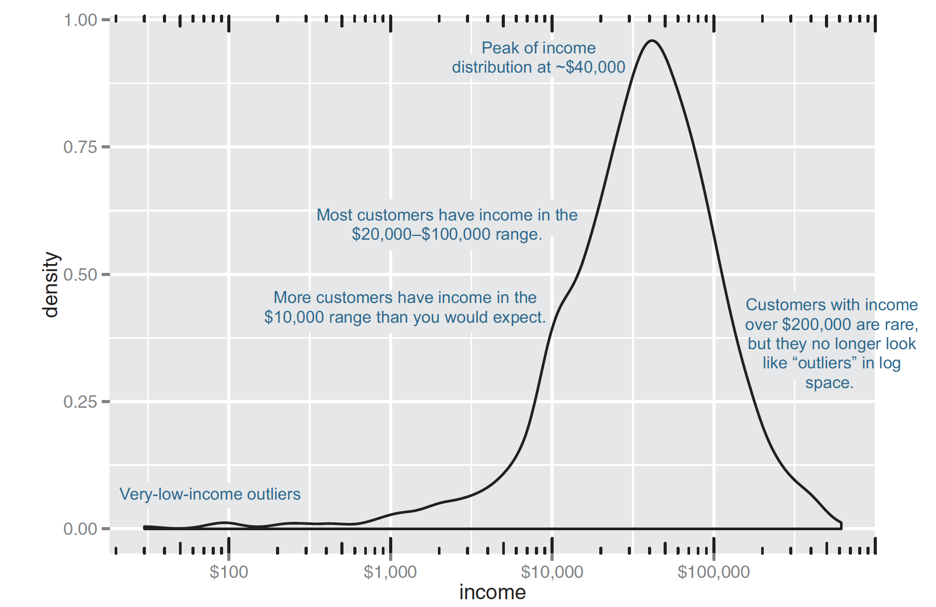
Density Plots
bring out more detail is to plot the distribution on a logarithmic scale
ggplot(custdata) + geom_density(aes(x=income)) + scale_x_log10(breaks=c(100,1000,10000,100000), labels=dollar) + annotation_logticks(sides="bt")
Warning messages:
1: In self$trans$transform(x) : NaNs produced
2: Transformation introduced infinite values in continuous x-axis
3: Removed 79 rows containing non-finite values (stat_density).
Figure3.5, Practical Data Science with R by Nina Zumel, John Mount

Slide 78
Log transformations for skewed and wide distributions
data with values that range over several orders of magnitude
modeling techniques often have a difficult time with very wide data ranges
data often comes from multiplicative processes, so log units are in some sense more natural
additive vs multiplicative:
a change to a restaurant menu increases patronage every night by 5%
Practical Data Science with R by Nina Zumel, John Mount​

Slide 79
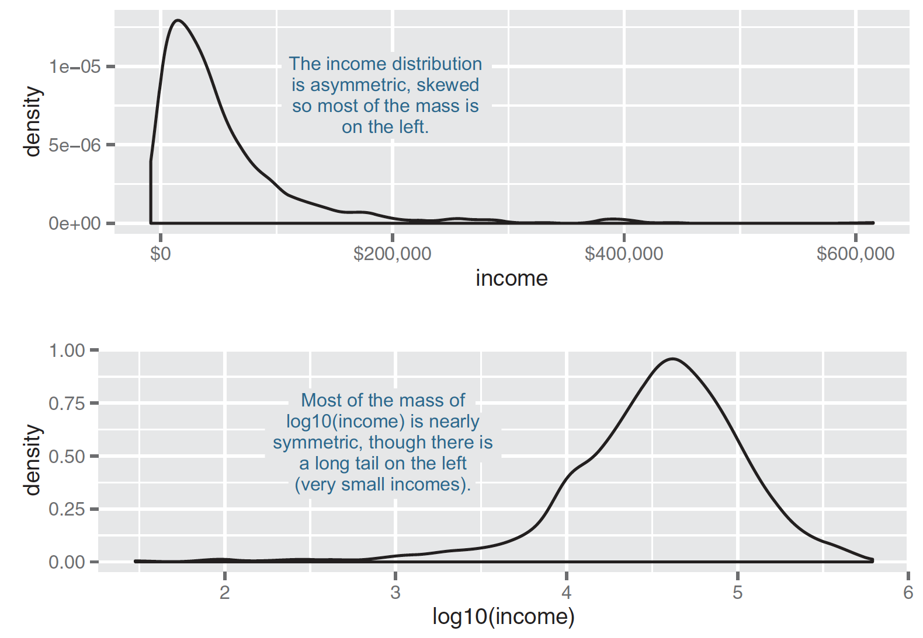
A nearly lognormal distribution and its log
Fiure4.4, Practical Data Science with R by Nina Zumel, John Mount

Slide 80
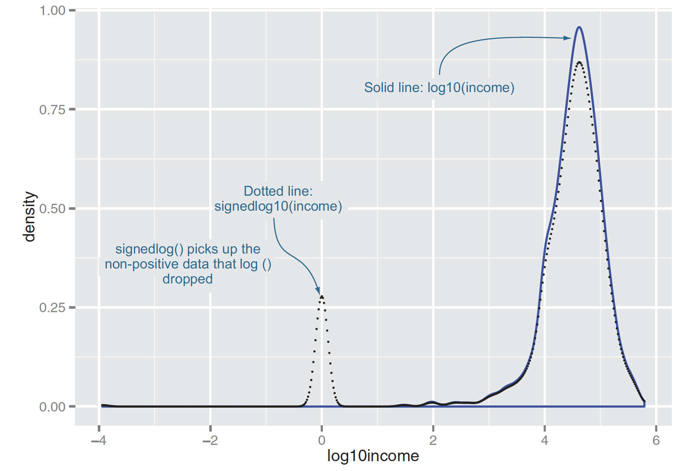
If the data is negative?
signedlog10 <- function(x) {
ifelse(abs(x) <= 1,0,sign(x)*log10(abs(x)))
}
Figure4.5, Practical Data Science with R by Nina Zumel, John Mount

Slide 81
Intentional view of variables
Explanatory variables : variables you can control
Nuisance variables : important variables you can’t control
Omitted variables : important variables you don’t know
Practical Data Science with R by Nina Zumel, John Mount

Slide 82
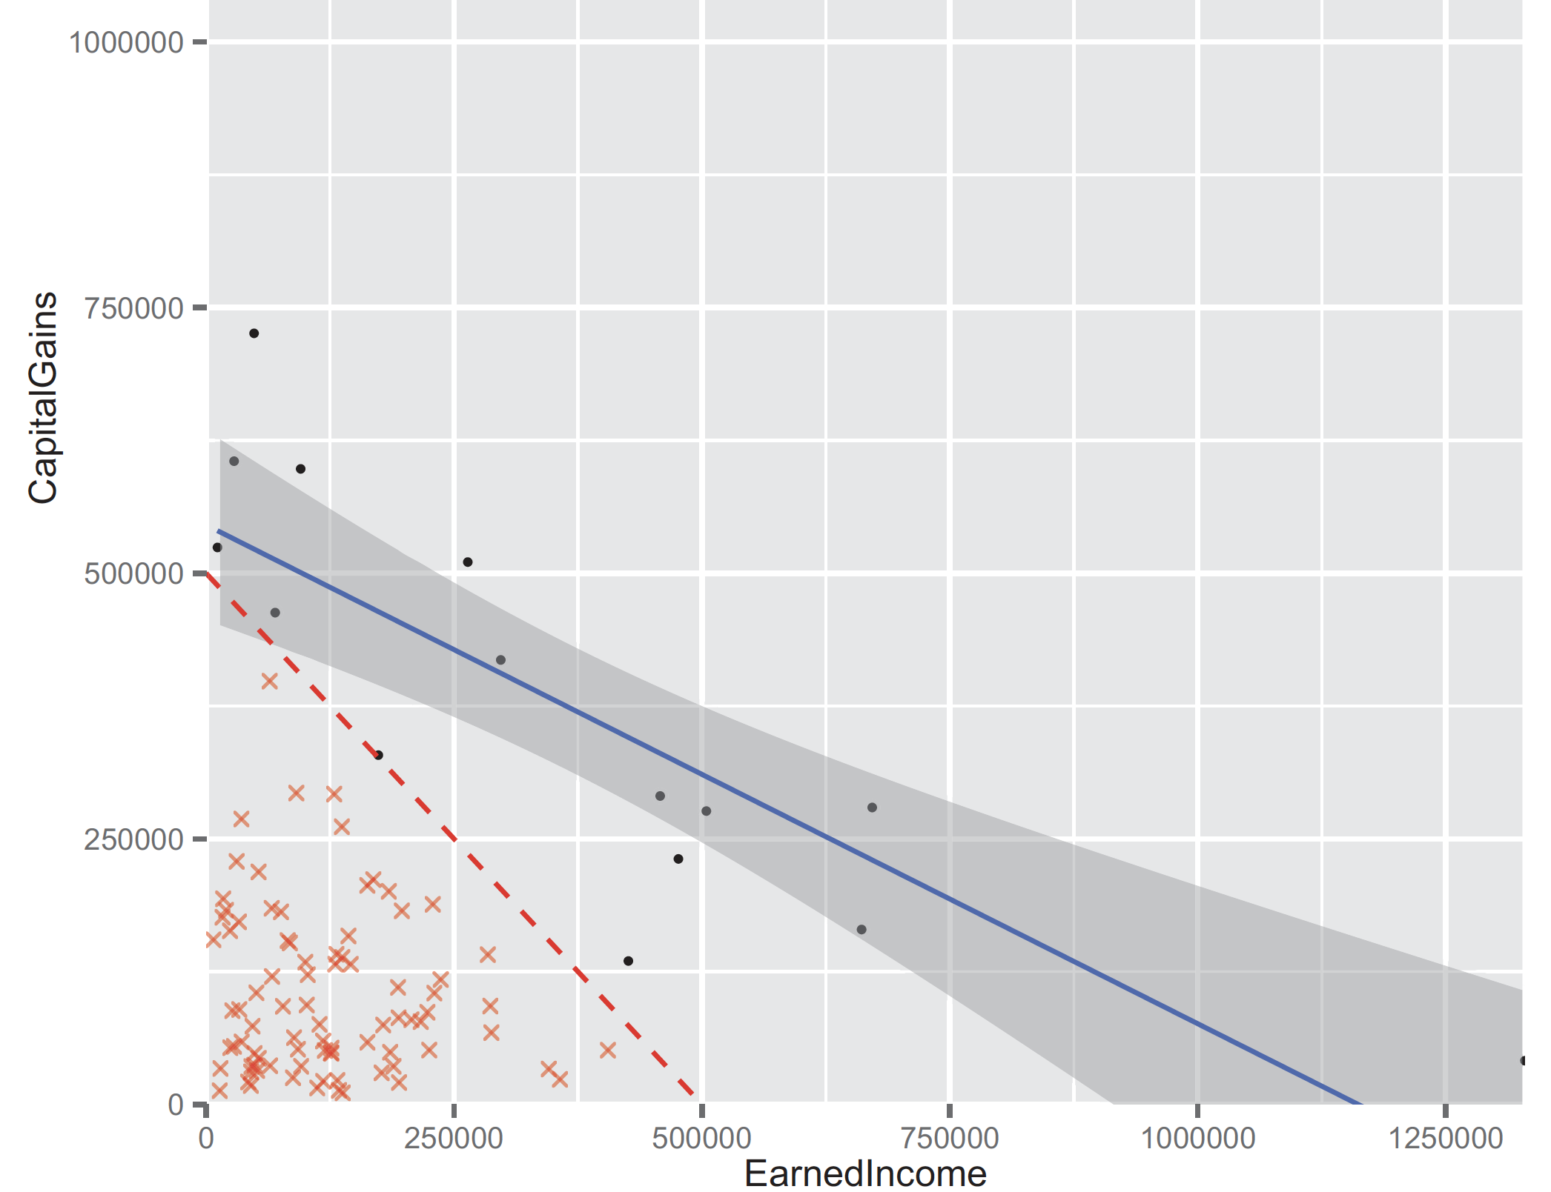
Sampling bias
veryHighIncome <- subset(d, EarnedIncome+CapitalGains>=500000)
print(with(veryHighIncome,cor.test(EarnedIncome,CapitalGains, method='spearman')))
Figure B.9, Practical Data Science with R by Nina Zumel, John Mount

Slide 83
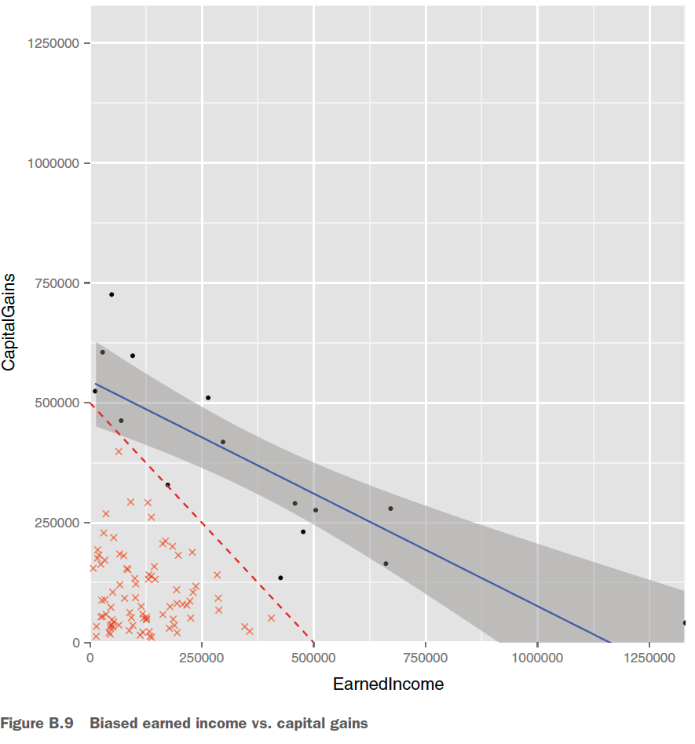
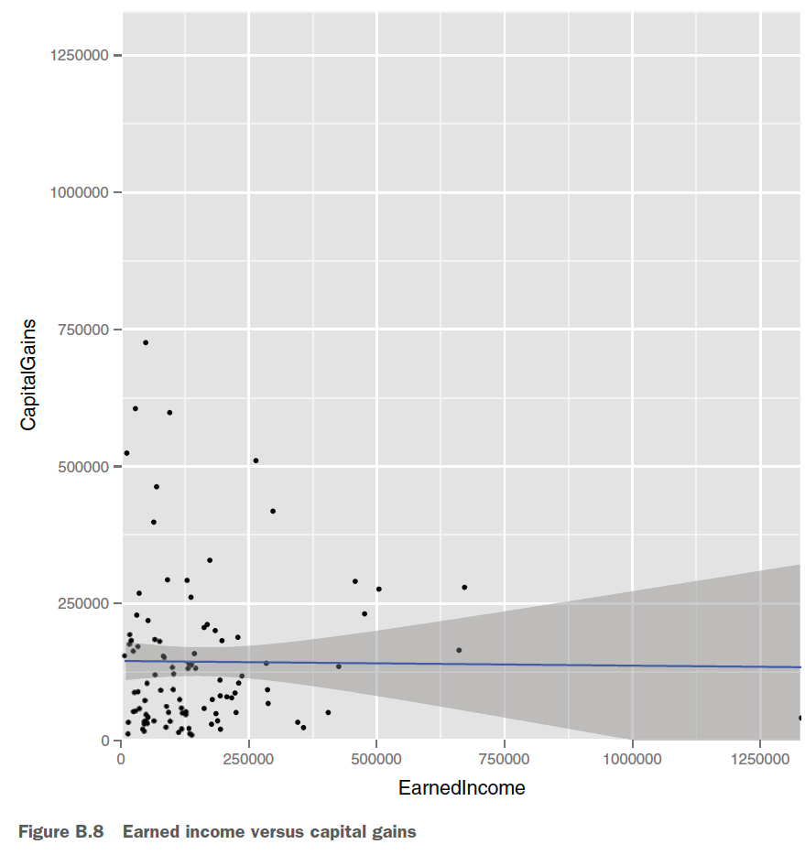
Sample Bias
Appendix B, Practical Data Science with R by Nina Zumel, John Mount

Slide 84
Summary
What you do with missing values depends on how many there are, and whether they’re missing randomly or systematically.
When in doubt, assume that missing values are missing systematically.
Appropriate data transformations can make the data easier to understand and easier to model.
Normalization and rescaling are important when relative changes are more important than absolute ones.
Data provenance records help reduce errors as you iterate over data collection, data treatment, and modeling.
Practical Data Science with R by Nina Zumel, John Mount

Slide 85
How to handle imbalance data set?

Slide 86
Tour of Data Sampling Methods for Imbalanced Classification
https://machinelearningmastery.com/data-sampling-methods-for-imbalanced-classification/

Slide 87
Problem of an Imbalanced Class Distribution

Slide 88
Oversampling Techniques
Random Oversampling
Synthetic Minority Oversampling Technique (SMOTE)
Borderline-SMOTE
Borderline Oversampling with SVM
Adaptive Synthetic Sampling (ADASYN)

Slide 89
Oversampling Techniques
The simplest oversampling method involves randomly duplicating examples from the minority class in the training dataset, referred to as Random Oversampling.
The most popular and perhaps most successful oversampling method is SMOTE; that is an acronym for Synthetic Minority Oversampling Technique.
SMOTE works by selecting examples that are close in the feature space, drawing a line between the examples in the feature space and drawing a new sample as a point along that line.
There are many extensions to the SMOTE method that aim to be more selective for the types of examples in the majority class that are synthesized.
Borderline-SMOTE involves selecting those instances of the minority class that are misclassified, such as with a k-nearest neighbor classification model, and only generating synthetic samples that are “difficult” to classify.
Borderline Oversampling is an extension to SMOTE that fits an SVM to the dataset and uses the decision boundary as defined by the support vectors as the basis for generating synthetic examples, again based on the idea that the decision boundary is the area where more minority examples are required.
Adaptive Synthetic Sampling (ADASYN) is another extension to SMOTE that generates synthetic samples inversely proportional to the density of the examples in the minority class. It is designed to create synthetic examples in regions of the feature space where the density of minority examples is low, and fewer or none where the density is high.

Slide 90
Undersampling Techniques
Random Undersampling
Condensed Nearest Neighbor Rule (CNN)
Near Miss Undersampling
Tomek Links Undersampling
Edited Nearest Neighbors Rule (ENN)
One-Sided Selection (OSS)
Neighborhood Cleaning Rule (NCR)

Slide 91
Undersampling Techniques
The simplest undersampling method involves randomly deleting examples from the majority class in the training dataset, referred to as random undersampling.
One group of techniques involves selecting a robust and representative subset of the examples in the majority class.
The Condensed Nearest Neighbors rule, or CNN for short, was designed for reducing the memory required for the k-nearest neighbors algorithm. It works by enumerating the examples in the dataset and adding them to the store only if they cannot be classified correctly by the current contents of the store, and can be applied to reduce the number of examples in the majority class after all examples in the minority class have been added to the store.
Near Miss refers to a family of methods that use KNN to select examples from the majority class. NearMiss-1 selects examples from the majority class that have the smallest average distance to the three closest examples from the minority class. NearMiss-2 selects examples from the majority class that have the smallest average distance to the three furthest examples from the minority class. NearMiss-3 involves selecting a given number of majority class examples for each example in the minority class that are closest.

Slide 92
Undersampling Techniques
nother group of techniques involves selecting examples from the majority class to delete. These approaches typically involve identifying those examples that are challenging to classify and therefore add ambiguity to the decision boundary.
Perhaps the most widely known deletion undersampling approach is referred to as Tomek Links, originally developed as part of an extension to the Condensed Nearest Neighbors rule. A Tomek Link refers to a pair of examples in the training dataset that are both nearest neighbors (have the minimum distance in feature space) and belong to different classes. Tomek Links are often misclassified examples found along the class boundary and the examples in the majority class are deleted.
The Edited Nearest Neighbors rule, or ENN for short, is another method for selecting examples for deletion. This rule involves using k=3 nearest neighbors to locate those examples in a dataset that are misclassified and deleting them.
The ENN procedure can be repeated multiple times on the same dataset, better refining the selection of examples in the majority class. This extension is referred to initially as “unlimited editing” although it is more commonly referred to as Repeatedly Edited Nearest Neighbors.
Staying with the “select to keep” vs. “select to delete” families of undersampling methods, there are also undersampling methods that combine both approaches.
One-Sided Selection, or OSS for short, is an undersampling technique combines Tomek Links and the Condensed Nearest Neighbor (CNN) Rule. The Tomek Links method is used to remove noisy examples on the class boundary, whereas CNN is used to remove redundant examples from the interior of the density of the majority class.
The Neighborhood Cleaning Rule, or NCR for short, is another combination undersampling technique that combines both the Condensed Nearest Neighbor (CNN) Rule to remove redundant examples and the Edited Nearest Neighbors (ENN) Rule to remove noisy or ambiguous examples.

Slide 93
Combinations of Techniques
Although an oversampling or undersampling method when used alone on a training dataset can be effective, experiments have shown that applying both types of techniques together can often result in better overall performance of a model fit on the resulting transformed dataset.
Some of the more widely used and implemented combinations of data sampling methods include:
SMOTE and Random Undersampling
SMOTE and Tomek Links
SMOTE and Edited Nearest Neighbors Rule

Slide 94
Combinations of Techniques
SMOTE is perhaps the most popular and widely used oversampling technique. As such, it is typical paired with one from a range of different undersampling methods.
The simplest pairing involves combining SMOTE with random undersampling, which was suggested to perform better than using SMOTE alone in the paper that proposed the method.
It is common to pair SMOTE with an undersampling method that selects examples from the dataset to delete, and the procedure is applied to the dataset after SMOTE, allowing the editing step to be applied to both the minority and majority class. The intent is to remove noisy points along the class boundary from both classes, which seems to have the effect of the better performance of classifiers fit on the transformed dataset.
Two popular examples involve using SMOTE followed by the deletion of Tomek Links, and SMOTE followed by the deletion of those examples misclassified via a KNN model, the so-called Edited Nearest Neighbors rule.

Slide 95
vtreat package

Slide 96
vtreat package
an automatic and repeatable process for dealing with missing data
The vtreat process creates a treatment plan that records all the information needed to repeat the data treatment process
use this treatment plan to “prepare” or treat your training data before you fit a model, and then again to treat new data before feeding it into the model.
Credit by chapter 4.1.3, Practical Data Science with R by Nina Zumel, John Mount

Slide 97
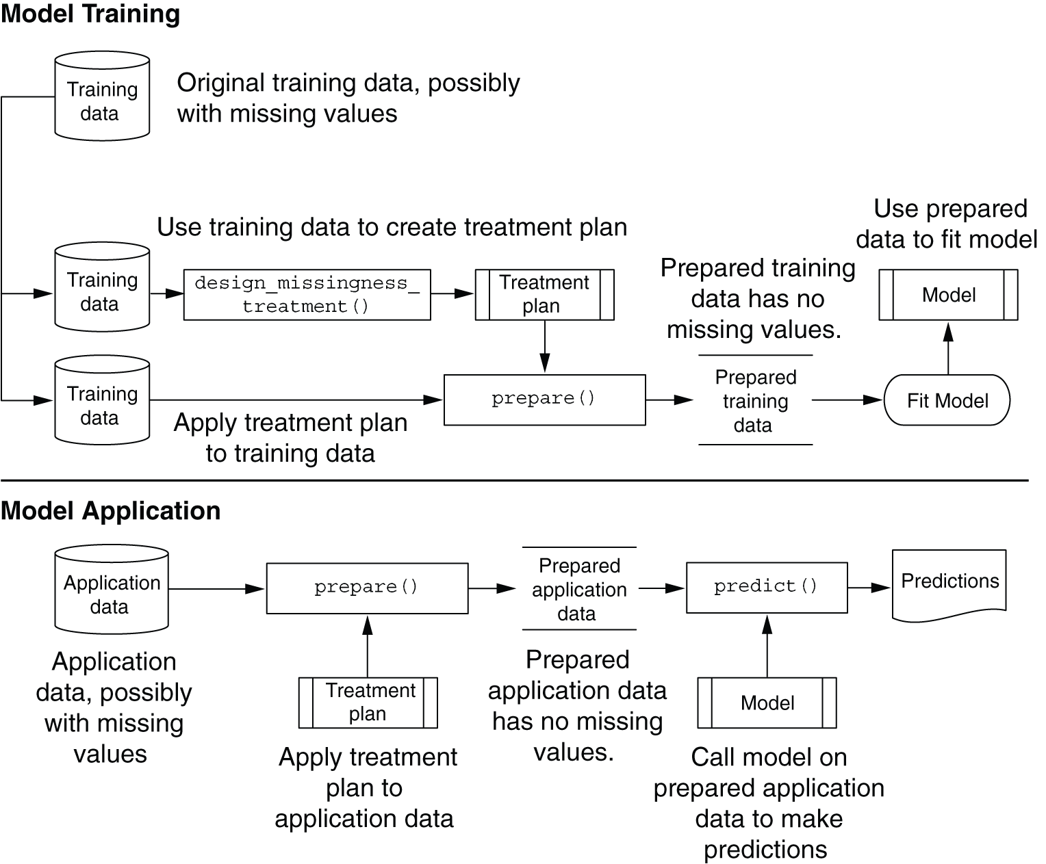
Creating and applying a simple treatment plan
Credit by Figure 4.7, Practical Data Science with R by Nina Zumel, John Mount

Slide 98
Summary
Take the time to examine your data before diving into the modeling.
The summary command helps you spot issues with data range, units, data type, and missing or invalid values.
Visualization additionally gives you a sense of data distribution and relationships among variables.
Visualization is an iterative process and helps answer questions about the data. Time spent here is time not wasted during the modeling process.
Practical Data Science with R by Nina Zumel, John Mount

Slide 99
Supervised & Unsupervised learning

Slide 100
supervised vs. unsupervised learning
supervised learning
Input: a set of p features X₁,X₂, . . .,X_{p}, measured on n observations, and a response Y also measured on those same n observations
Goal: predict Y using X₁,X₂, . . . , X_{p}
unsupervised learning
Input: X₁ ,X₂ , . . . , X_{p} measured on n observations
Output: discover interesting things about the measurements
An Introduction to Statistical Learning with Applications in R by Gareth James, Daniela Witten, Trevor Hastie,Robert Tibshirani

Slide 101
Mapping problems to machine learning tasks
Predicting what customers might buy, based on past transactions
Identifying fraudulent transactions
Determining price elasticity (the rate at which a price increase will decrease sales, and vice versa) of various products or product classes
Determining the best way to present product listings when a customer searches for an item
Practical Data Science with R by Nina Zumel, John Mount

Slide 102
Mapping problems to machine learning tasks
Customer segmentation: grouping customers with similar purchasing behavior
AdWord valuation: how much the company should spend to buy certain AdWords on search engines
Evaluating marketing campaigns
Organizing new products into a product catalog
Practical Data Science with R by Nina Zumel, John Mount

Slide 103
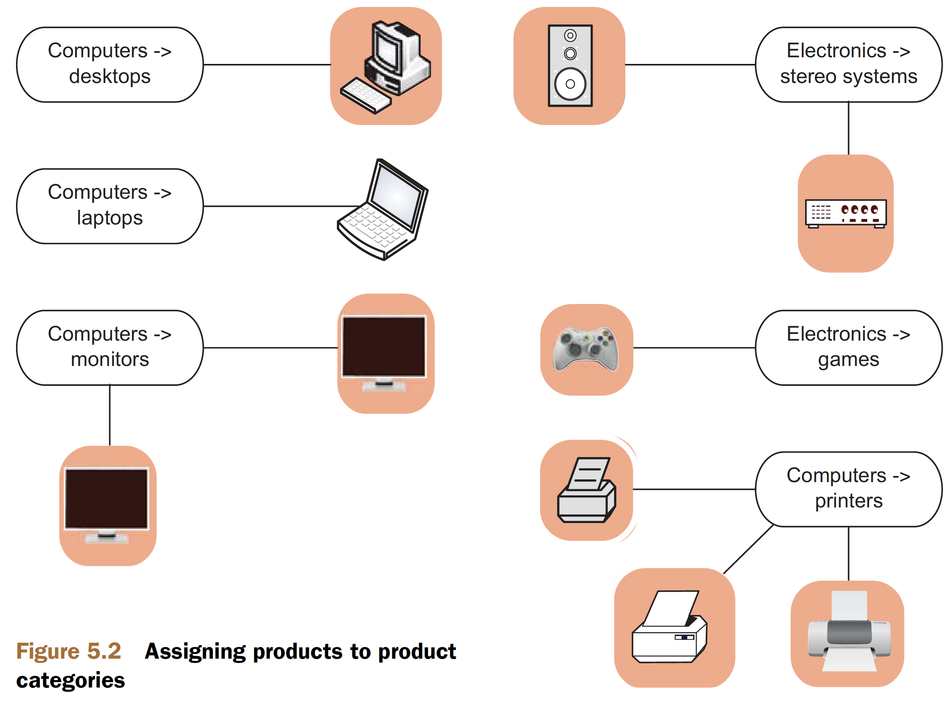
Solving classification problems
Figure 5.2, Practical Data Science with R by Nina Zumel, John Mount

Slide 104
Solving classification problems
Classification itself is an example of what is called supervised learning.
Multicategory vs. two-category classification
using binary classifiers to solve multicategory problems : building one classifier for each category (a 1-vs-rest classifier)
in most cases a suitable multiple-category implementation better than multiple binary classifiers
Use the package mlogit instead of the base method glm for logistic regression
Practical Data Science with R by Nina Zumel, John Mount​

Slide 105
Solving classification problems
Some common classification methods
Naive Bayes : a good first attempt at solving the product categorization problem.
Decision trees : an important extension of decision trees - random forests
Logistic regression : estimate class probabilities (the probability that an object is in a given class) in addition to class assignments
Support vector machines : SVMs make fewer assumptions about variable distribution than do many other methods
Practical Data Science with R by Nina Zumel, John Mount​

Slide 106
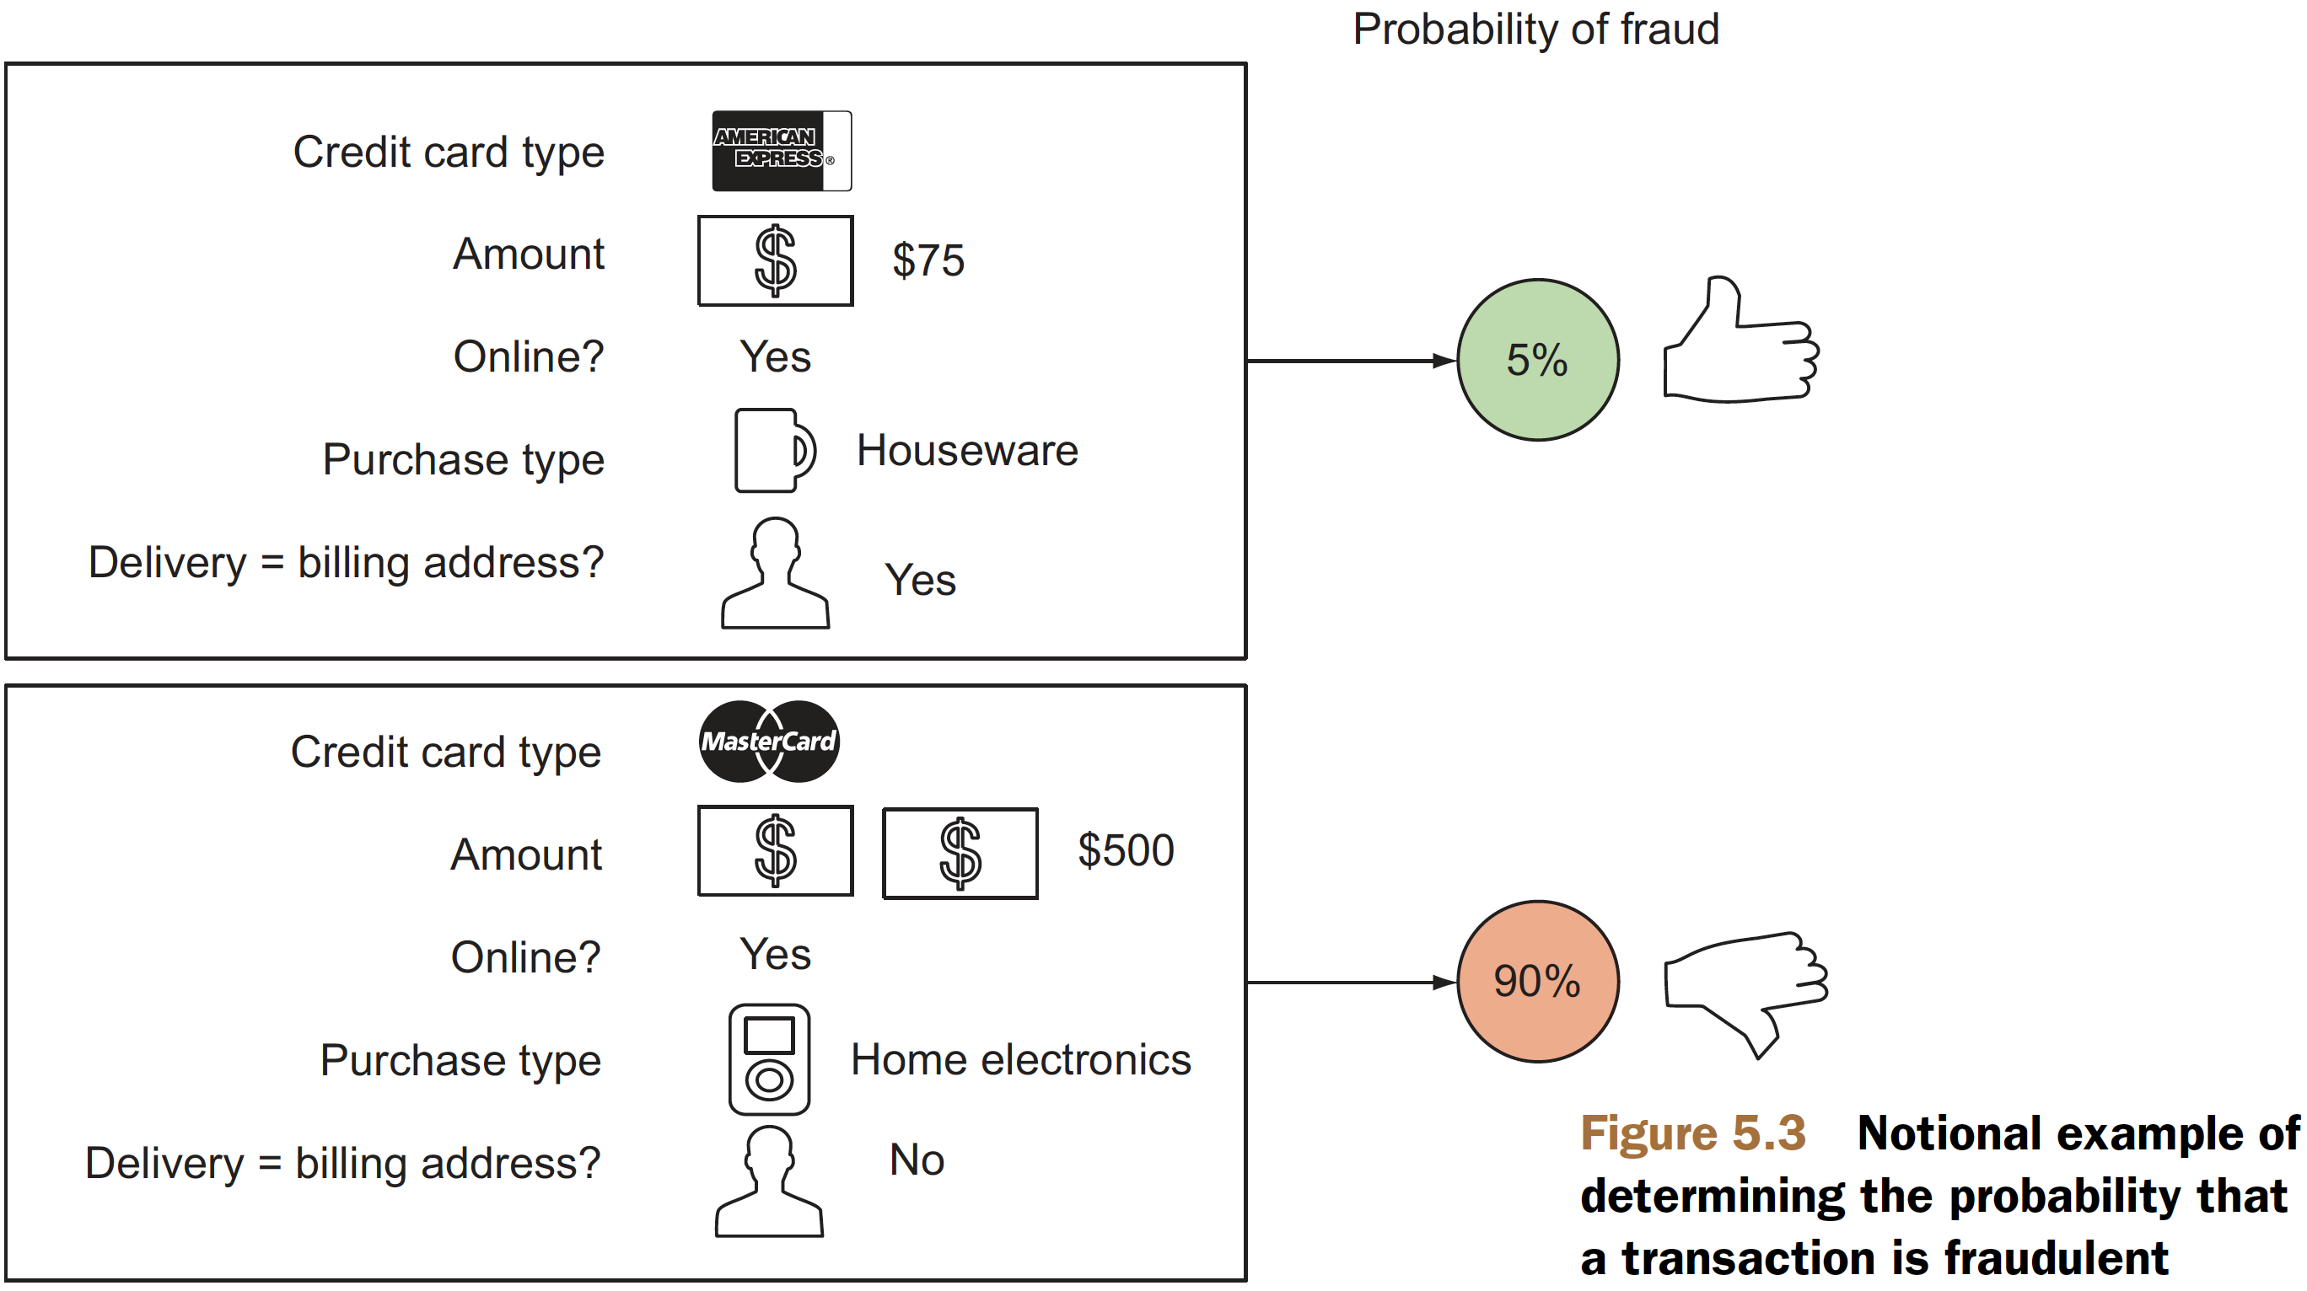
Solving scoring problems
Figire5.3, Practical Data Science with R by Nina Zumel, John Mount​

Slide 107
Solving scoring problems
Linear regression
builds a model such that the predicted numerical output is a linear additive function of the inputs.
a good first model to try when trying to predict a numeric value
Logistic regression
always predicts a value between 0 and 1
if what you want to estimate is the probability that a given transaction is fraudulent or legitimate.
Practical Data Science with R by Nina Zumel, John Mount​

Slide 108
Working without known targets
unsupervised learning
there’s not (yet) a specific outcome that you want to predict
discover similarities and relationships in the data. rather than predicting outputs based on inputs
common clustering methods
K-means clustering
Nearest neighbor
apriori algorithm for finding association rules
Practical Data Science with R by Nina Zumel, John Mount​

Slide 109
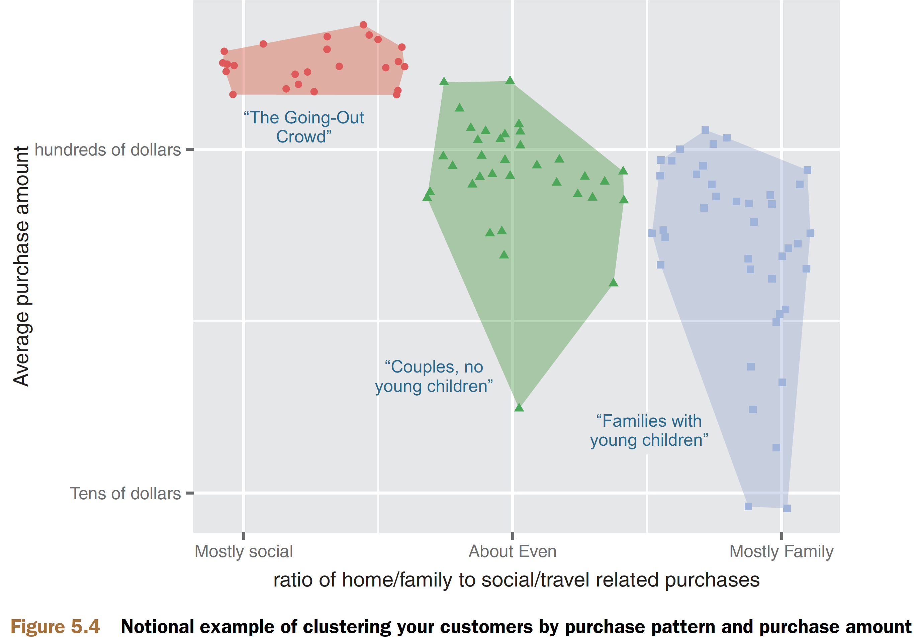
When to use basic clustering
Figure5.4, Practical Data Science with R by Nina Zumel, John Mount​

Slide 110
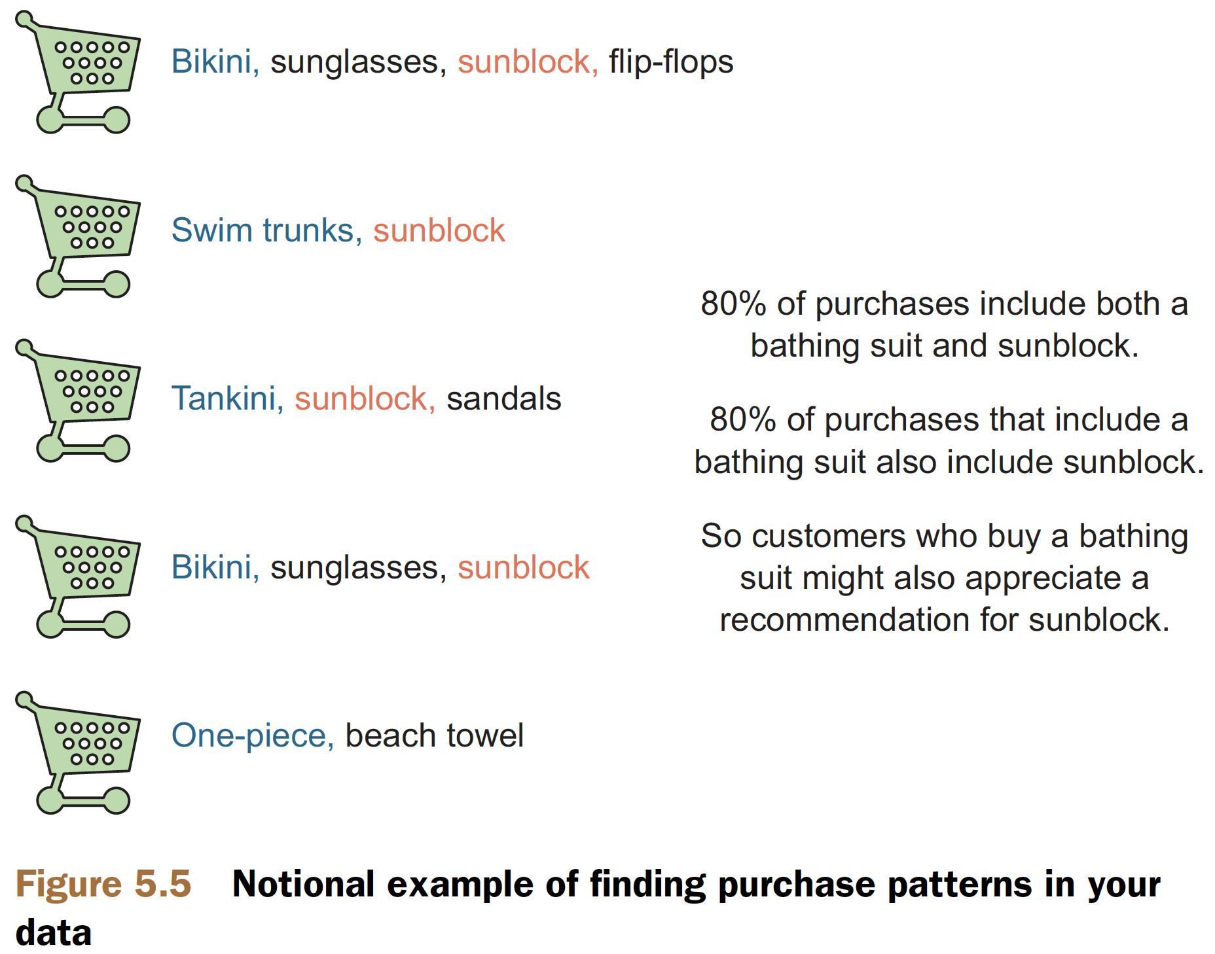
When to use association rules
Figure5.5, Practical Data Science with R by Nina Zumel, John Mount​

Slide 111
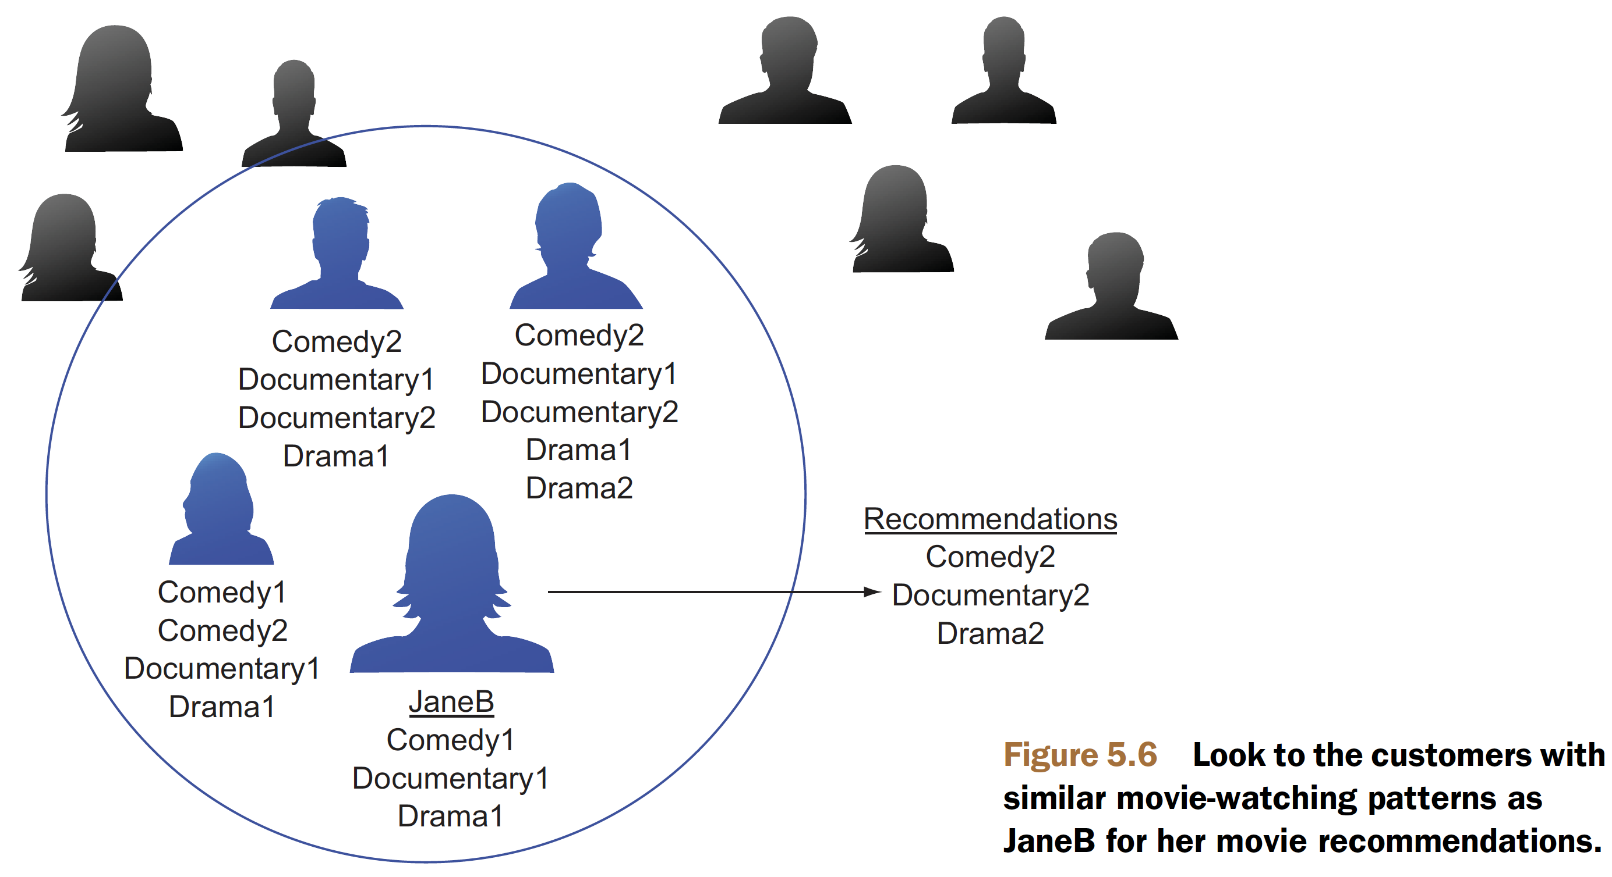
When to use nearest neighbor methods
Figure5.6, Practical Data Science with R by Nina Zumel, John Mount​

Slide 112


Thank You Any Question?

